Slide 1
Performance and Traffic Management

Slide 2
Introduction
WSNs are collections of compact-size, relatively inexpensive computational nodes that measure local environmental conditions or other parameters and forward such information to a central point for appropriate processing.
The performance of WNSs is affected strongly by other parameters in two groups: basic models and network models.
Basic models form the elementary blocks based on which the network models can be analyzed and the overall system performance studied.

Slide 3
Background
WSNs usually consist of hundreds or thousands of sensor nodes scattered in a geographical area and one or multiple sink(s) for collecting information and transmitting it through wireless channels
The special design and characteristics of sensors and their applications make WSNs different from traditional networks.
Most traffic in WSNs flows star like from sensor nodes to the sink. If there are multiple sinks, multiple traffic flows will be generated between sensor nodes and the sink.

Slide 4
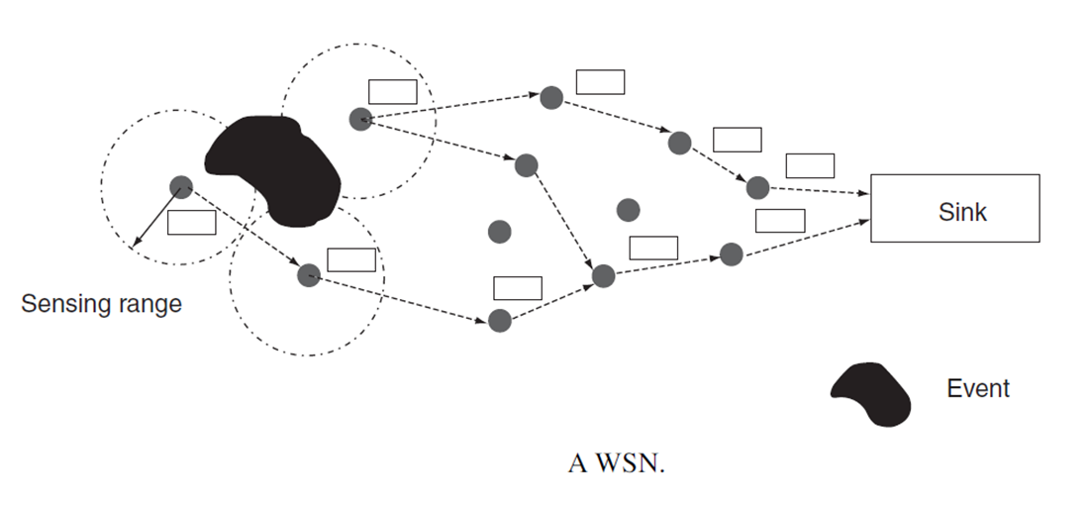

Slide 5
Sensor Groups
Specialized sensing platform
Small in size and memory
Narrow communication bandwidth
Short radio distance
Generic sensing platform
Designed using off-the-shelf components
Bandwidth of 100kbps or more
More memory than 1
High bandwidth sensing devices
Broader bandwidth than 2
Bluetooth based radio
Larger memory
Gateway like sensor node
Act as gateway to directly connect sensor devices

Slide 6
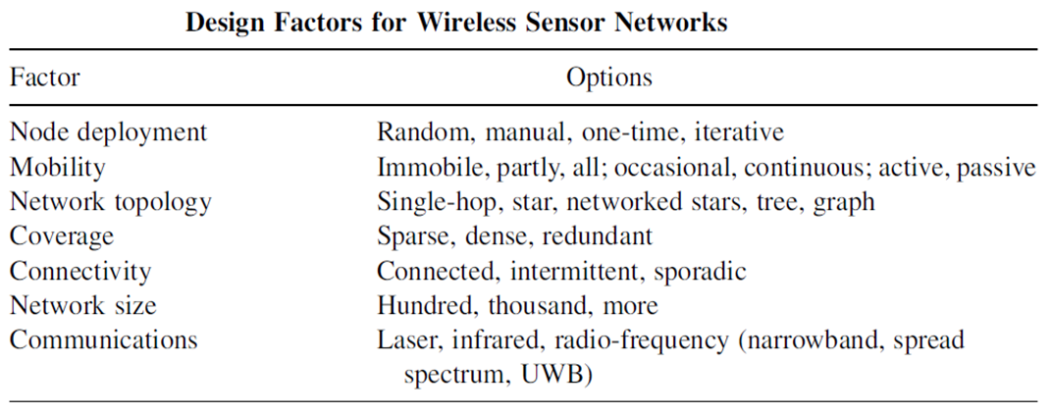
The data related to the events are usually small, usually just a few bytes and in many cases just a few bits. Therefore, it may be possible to transmit more than one event in a single data unit if the application reporting frequency allows it.
The factors that have a direct impact on the system performance of WSNs.

Slide 7
Communication Architecture
network (or internetworking)
data link
physical
transport
other higher layers, including session, presentation, and application

Slide 8
WSN Design Issues - MAC Protocols
To share the medium between sensors
Energy wastage may be due to
Packet collision and retransmission
Control packets like RTS/CTS
Overhearing and idle listening
The choice of the medium access control protocol is the major determining factor in WSN performance depends on the choice of MAC protocol.
MAC affects the efficiency and reliability of hop-by-hop data transmission.
Existing MAC protocols such as IEEE 802 series standard may not be completely suitable for WSNs because of energy efficiency.
Emphasize on energy efficiency
Parameters used to measure performance of MAC protocols include collision probability, control overhead, delay, and throughput.

Slide 9
WSN Design Issues Routing Protocols
Used for setting up one or more path(s) from sensor nodes to the sink.
Since sensor nodes have limited resources, routing protocols should have a small overhead, which may result from control message interchange and caching.
Traditional address-centric routing protocols for Internet do not meet the requirements of WSNs.
Data centric protocols are more suitable because they can be deployed easily and due to data aggregation energy is saved.

Slide 10
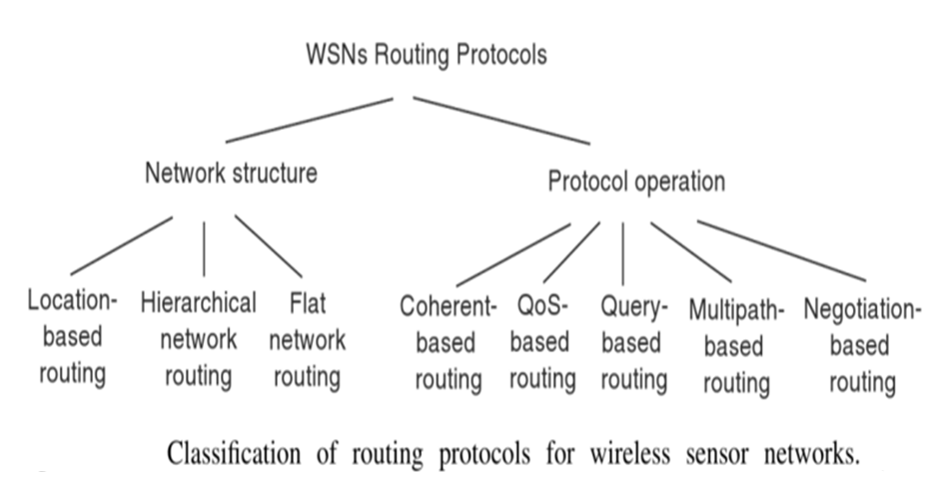

Slide 11
WSN Design Issues Transport Protocols
Factors to be considered in the design of transport protocols: congestion control mechanism and reliability guarantee.
MAC protocol has no way to handle packet loss as a result of buffer overflow. Transport protocols should have mechanisms for loss recovery; to guarantee reliability, mechanisms such as ACK and selective ACK used in the TCP
100% reliability is not required in WSN, it is enough to guarantee a certain ratio of successful transmission
Better to have hop-by-hop mechanism for congestion control and loss recovery since it reduces the buffer requirement at intermediate nodes

Slide 12
Performance modeling of WSNs: Performance metrics
System lifetime:
the duration of time until some node depletes all its energy;
the duration of time until the QoS of applications cannot be guaranteed; or
the duration of time until the network has been disjoined.
Energy efficiency: The number of packets that can be transmitted successfully using a unit of energy. Packet collision, routing overhead, packet loss, and packet retransmission reduce energy efficiency
Reliability: Event reliability is used as a measure to show how reliable the sensed event can be reported to the sink.

Slide 13
Coverage: Full coverage by a sensor network means the entire space that can be monitored by the sensor nodes. If a sensor node becomes dysfunctional due to energy depletion, there is a certain amount of that space that can no longer be monitored. The coverage is deﬁned as the ratio of the monitored space to the entire space.
Connectivity: For multihop WSNs, it is possible that the network becomes disjointed because some nodes become dysfunctional. The connectivity metric can be used to evaluate how well the network is connected and / or how many nodes have been isolate
QoS metrics: Some applications in WSNs have real-time properties. These applications may have QoS requirements such as delay, loss ratio, and bandwidth.

Slide 14
Performance modeling of WSNs: Basic Models
Basic Models
Traffic Model
Energy Models
Continuous Delivery
Query-Based Delivery
Event-Based Delivery
Model for Sensing
Model for Communication
Model for Computation
Hybrid Delivery
Node Model
Active
Sleep

Slide 15
Traffic Model
Event based Delivery
Sensor nodes monitor the occurrence of events passively and continuously
When the event occurs the sensor node begins to report the event to the sink
Routing approaches
Routing on-demand
Setting up of path in advance
Adaptive approach
Continuous Delivery
Reporting data continuously or periodically
Query-Based Delivery
Sink issues query and get the up-to-date value for information
Query messages contains type of information required, reporting frequency and other parameters of interest to sink
Hybrid Delivery
Based on sensor node type some information are sent regularly, some are delivered on request from sink

Slide 16


Energy Models
To reduce energy consumption
Design Communication system that conserves energy inherently by turning off the transceiver for a period of time
Reduce the volume of communications through in-network processing using data aggregation and data compression
Model for Sensing:
The energy required to sense an area with radius r_{s} is proportional to r_{s} ² or r_{s} ⁴
Model for Communication:
Energy required for transmitting l-bit data over a distance d is
Energy required for receiving l-bit data over a distance d is
E_{c} is the base energy = 50 nJ/bit for a 1-Mbps transceiver
d_{cr} is the crossover distance = 86.2 m

Slide 17


Total energy for transmitting l-bit data from source i to destination j is
Optimal distance between relay nodes (d_{m}) is
Optimal hop count (H) is H= d/d_{m}
Model for Computation:
Low power – CPU consumes low energy per clock cycle
Energy Efficiency – energy consumed per instruction
ATMega 128L 242 MIPS/W or 4nJ/instruction
ARM Thumb 480 MIPS/W or 2.1 nJ/instruction

Slide 18
Node Model
Sensor nodes have 2 states:
Active
Passive
Length of active and sleep periods are geometrically distributed random variables with a mean value of p and q time slots respectively.
Sub phases of Active state:
R state-Transmit or receive data and / or generate data according to Poisson process with an average rate of g
N State-Nodes can transmit data only if there are packets backlogged in their buffer

Slide 19
Two state Discrete Time Markov Chain (DTMC) Model
Two state Discrete Time Markov Chain (DTMC) Model
Wait state – All the next hop nodes are in either the S or N state and unable to receive data
Forwarding state –There is at least one next hop node in state R and it can receive the data
The stationary distribution of a node’s state p can be calculated given the successful transmission probability of the data (b) and the probability that the data are received in a time slot (a).
Using p, other metrics that can be computed are:
Average number of data generated in a time slot
Sensor throughput or average number of data forwarded by the sensor in a time slot
Average buffer occupancy in sensor node.

Slide 20

Performance modeling of WSNs: Network Models
Network Models
MAC
Model
Routing
Models
System
Model
Channel access is controlled and allocated by MAC protocols.
energy consumed for a generic route P, P[E] can be computed as follows:

Slide 21
MAC Model
In a decentralized environment, packet collision may occur on the channel and should be handled by the MAC.
Performance parameter
Probability that data are transmitted successfully in a time slot (b).
Successful transmission probability is computed from l_{m,n}.
Let r be the common maximum radio range.
The one-hop transmission from transmitter i to the receiver j is successful if
Distance between i and j is less than or equal to r : d_{ij} >= r
For every other node, k, which is also receiving at the same time, d_{ik} > r
For every other node, l, which is transmitting at the same time, d_{lj}>r
l_{m,n} – the average transmission rate between node m and its generic receiver n

Slide 22
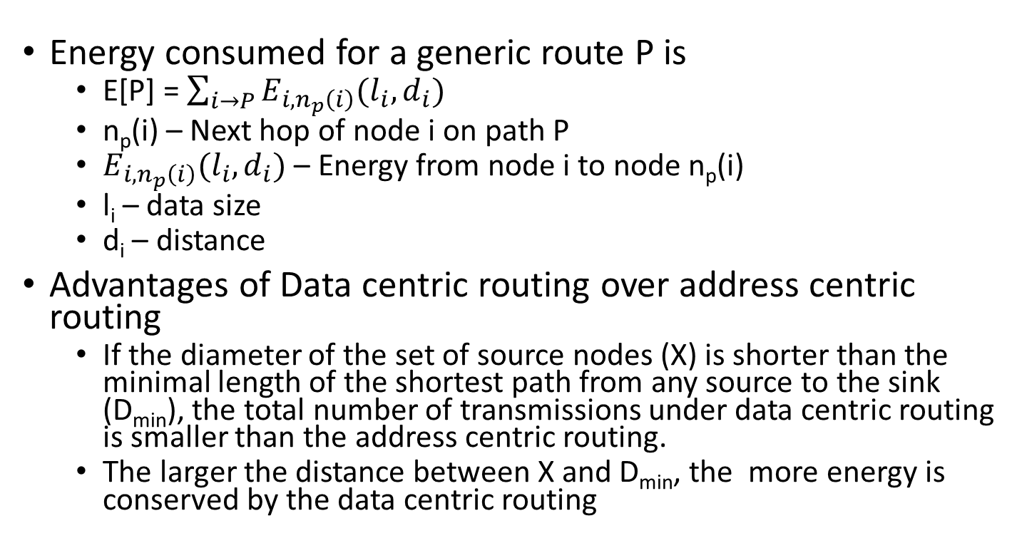
Routing Model
Energy consumed for a generic route P is
E[P] = $\sum_{i→P}{E_{i, n_{p}\left(i\right)}(l_{i}, d_{i})}$
n_{p}(i) – Next hop of node i on path P
$E_{i, n_{p}\left(i\right)}(l_{i}, d_{i})$ – Energy from node i to node n_{p}(i)
l_{i} – data size
d_{i} – distance
Advantages of Data centric routing over address centric routing
If the diameter of the set of source nodes (X) is shorter than the minimal length of the shortest path from any source to the sink (D_{min}), the total number of transmissions under data centric routing is smaller than the address centric routing.
The larger the distance between X and D_{min}, the more energy is conserved by the data centric routing

Slide 23
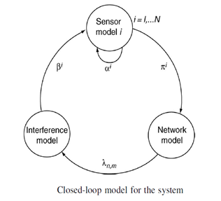
System Model
Closed loop model
Consists of 3 sub models
Sensor node model
Inference model
Network model
When transmitting data to the next hop a sensor node chooses the neighboring node that will result in the lowest energy consumption

Slide 24
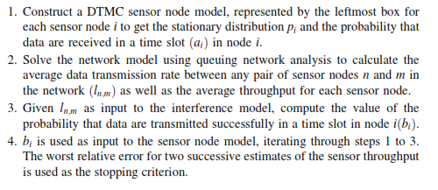
To calculate energy consumption and average delay

Slide 25
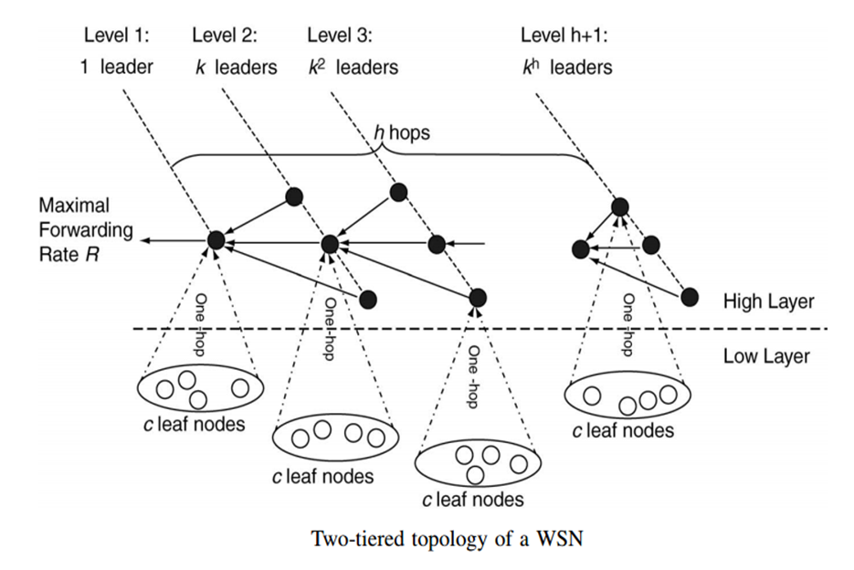
Case study: Simple computation of the system life span

Slide 26
Assumptions made in the model
All sensor nodes (N) in the network organize a two-tiered topology.
All sensor nodes are distributed equally and densely in a space for monitoring events.
Each higher-layer node (leader node) receives data from other leader nodes (k), its leaf nodes (c), as well as locally generated data.
There is a congestion and flow control mechanism between sink and sensor nodes to guarantee that in steady-state congestion will not occur;
Each sensor node has a maximum energy of E.
All nodes are stationary, and no adaptive power control would be assumed.

Slide 27


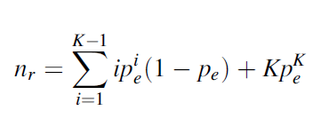
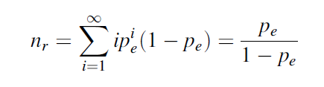

Analysis
Total Node Number:
Average Number of Retransmissions: Let be and p_{e} be bit-error probability and packet error probability, respectively
So, the average number of retransmissions will be:

Slide 28


Average Cost of Packet Forwarding in One Hop: In each hop, data consume the following amount of energy: transceiver (e_{t}), MAC-layer collision and idle and overhearing (e_{m}), and computation (e_{c}).
Therefore, the total energy consumed by forwarding a packet within one hop is about:
Converged Data Rate: For per-node fairness, each sensor node has the same data rate, r= n_{p}f ; therefore, r_{c} is given as follows:

Slide 29
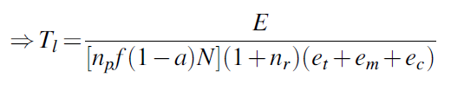
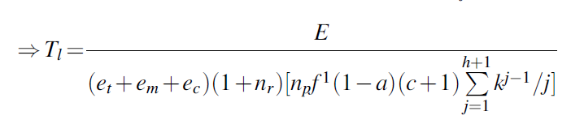
System Lifetime: Let’s assume that all sensor nodes become active at time t₀ = 0 and let’s assume that at time t1 the energy of the highest node at level 1 is depleted first. System lifetime Tl can be approximately T₁ = t₁- t₀. Here, the effects of node mobility and/or power control have been ignored. The quantity T₁ can be used as the lower bound of the system lifetime.
For per-node fairness,
For max-min fairness,

